Slide 1

Study Abroad:
How to Study Abroad as Pre-Health

Slide 2

Why Study Abroad?
Engage globally, contribute to building a better world; understand diversity
Take unique classes not offered at CU; within your major and not.
Do medical-related service learning or internships, obtain unique shadowing experiences
Discover a new culture or language and learn about yourself
Develop creativity, adaptability, and independence
Boost marketability for Medical or Health-focused graduate school
Have fun, meet new people, and TRAVEL!
Notes:
Before we start, I just want to take a moment to talk about the question, “Why Study Abroad?” Some of you may be sure that you’re going to pursue a study abroad experience, while others may still be exploring if it is right for you. There are a number of different reasons why students decide to study abroad, Perhaps to learn a new language or gain fluency in one you already know; to become more knowledgeable about the world and other cultures; to become more independent; to prepare for a career; and of course, to travel. You might be thinking “Is it too expensive?” “Can I fit it in to my academic plan?” “Will I still be able to graduate on time”? “Will I get homesick?”…. You can ask any of the peer advisors and they will tell you to “Just Do It”. This is truly the best time in to your life go abroad as you can earn academic credit, use financial aid, and have a support network to help you. During this presentation, be thinking about your “Why”. It is important to reflect on your reasons for studying abroad to know what it is you are looking to experience.

Slide 3
Am I eligible to study abroad?
2.5 GPA
Some programs have higher GPA requirements, be sure to check the criteria for the program that you are considering.
Sophomore standing
Completion of 2 full semesters on the Creighton campus before going abroad
No disciplinary sanctions:
Students on disciplinary probation are NOT eligible to apply for, or participate, in study abroad programs while on probation
Good academic standing
Satisfactory academic progress toward a degree
Notes:
“Am I eligible to study abroad?” All students must have a minimum 2.5 GPA or higher at the time of application in order to study abroad. Please be aware that some programs have a higher GPA requirement. For example, the Limerick Affiliate program requires a 2.9 GPA, ISEP requires a 2.75 GPA, and the Sophia Bilateral Exchange requires a 3.0. You also need to have completed 2 full semesters on the Creighton campus prior to departure. That means that you can study abroad the summer after your Freshman year or anytime thereafter. Students on disciplinary probation are NOT eligible to apply for or participate in study abroad while on probation. If you have been on disciplinary probation you must have one full semester between the end of your probationary period and your departure, with no additional incidents, in order to be eligible to depart. If you are part of the CARE Opportunities program, conditional study abroad approval may be possible. All students must also be in good academic standing.

Slide 4
Where can I go?
Argentina
Australia
Austria
Belgium
Botswana
Brazil
Bulgaria
Canada
Chile
Costa Rica
Czech Republic
Denmark
Dominican Republic
Egypt
El Salvador
Estonia
Fiji
Finland
France
Germany
Ghana
Greece
Hungary
Iceland
India
Indonesia
Italy
Japan
Jordan
Korea
Kuwait
Latvia
Lithuania
Malaysia
Malta
Mexico
Morocco
Netherlands
New Zealand
Norway
Nicaragua
Peru
Portugal
Puerto Rico
Russia
South Africa
Spain
Sweden
Switzerland
Taiwan
Thailand
Tunisia
Turkey
United Arab Emirates (UAE)
United Kingdom
Uruguay
AND MORE….!
Notes:
Creighton students have travelled just about anywhere you can think of. CU students are able to study in almost any country in the world that is not under a State Travel Warning. If you have questions about a particular site, talk to the Global Programs Coordinator.

Slide 5
Selecting A Program
Some things you’ll want to consider:
Specific for Pre-health:
In General:
 | Core classes available |  | Cost of Program / Local Costs
 | American or Foreign University |  | Location
 | Pre-health classes available |  | Length / Dates of Program
 | Length/Dates of Program |  | Class Size and Type
 | Class Dynamics (with locals, internationals, or U.S. students) |  | Structure of Program (group- based, independent)
 | Volunteer Opportunities |  | Internship Opportunities
 | Language Learning |  | Housing Options
 |  |  | Ease of Travel / Independence
Notes:
Before looking at any specific programs, it is a good idea to keep in mind any specific criteria that you would most like to have in a program. You also want to know what criteria is most important to you; in some cases a program will meet all of your criteria, but in other cases, you may find that a program meets only some of your criteria. For example, think about the courses you need to take, the cost of the program, if the courses are taught in English or the language of the host country, if the program offers immersion with locals or is primarily with other American students, or if the program provides volunteer, internship or travel opportunities.

Slide 6


Faculty-Led Programs Abroad (FLPA)
Location: | Worldwide
Length/Term: | Summer (most are 2, 3, or 4 weeks)
Financial Aid Portability: (Check w/ CU Financial Aid Office for details) | Federal Aid
Class Dynamics: | Courses with other Creighton students taught by a CU faculty member
Language of Instruction: | English
Other: | Programs fill quickly! Deadline is March 1, though most programs are full by December 1
Programs to highlight for Pre-Health:
England: BIO425 Development of Biological Thought
Haiti: JPS/ANT400 Public Health and Social Justice
MEDLIFE (Spring Break): Medical Service trips to Latin and South America

Slide 7

Encuentro Dominicano
Location: | Dominican Republic
Length/Term: | Fall or Spring Semester
Financial Aid Portability: | Institutional Aid and Federal Aid
Class Dynamics: | Courses with other Creighton students
Language of Instruction: | English & Spanish
Other: | Volunteer Service Sites, Immersion Trips w/ Host Family, Retreats, Potential to observe/assist in healthcare clinics
Academics:
EDP 361: Social Justice in the Dominican Republic (6 credits)
  CCAS Students=3 credits CORE for Global/International credit; 3 credits CORE per your designation; also certified writing
  HCB Students=3 credits International Culture Requirement; 3 credits CORE requirement.
  Nursing Students=May fulfill Skills requirements
Spanish (6 credits)
1 or 2 Elective courses (3 or 6 credits)

Slide 8
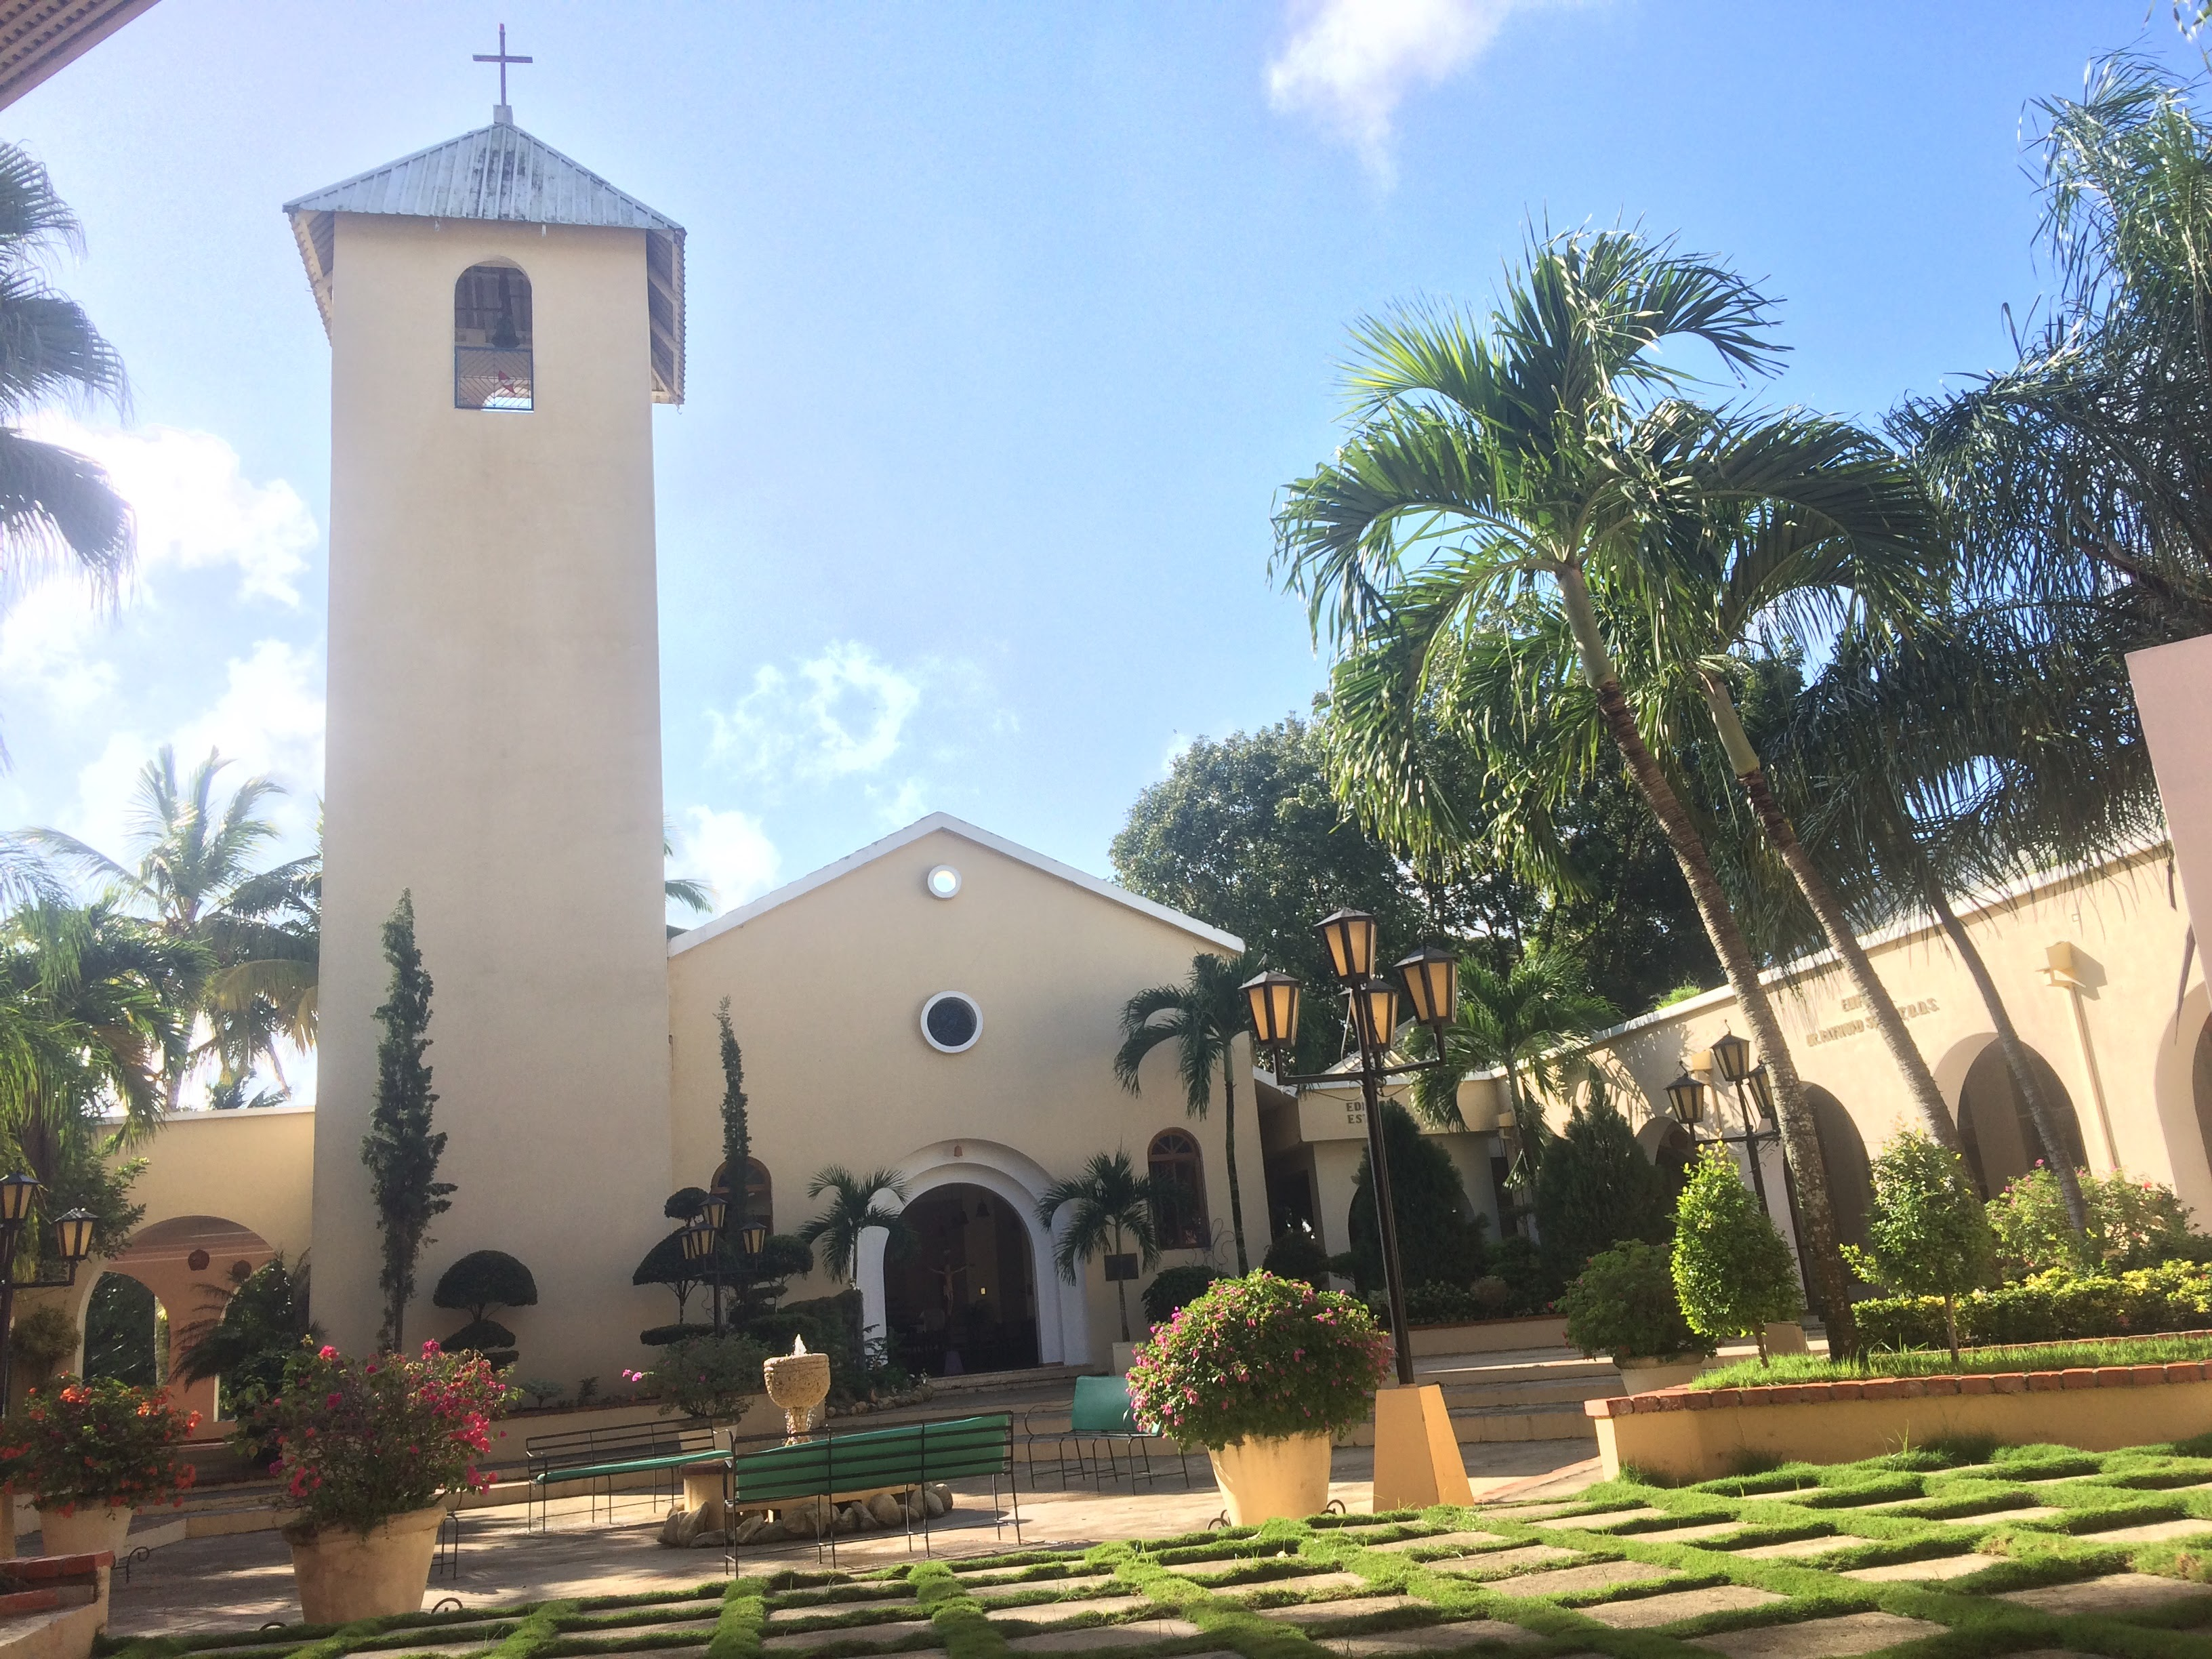

Slide 9
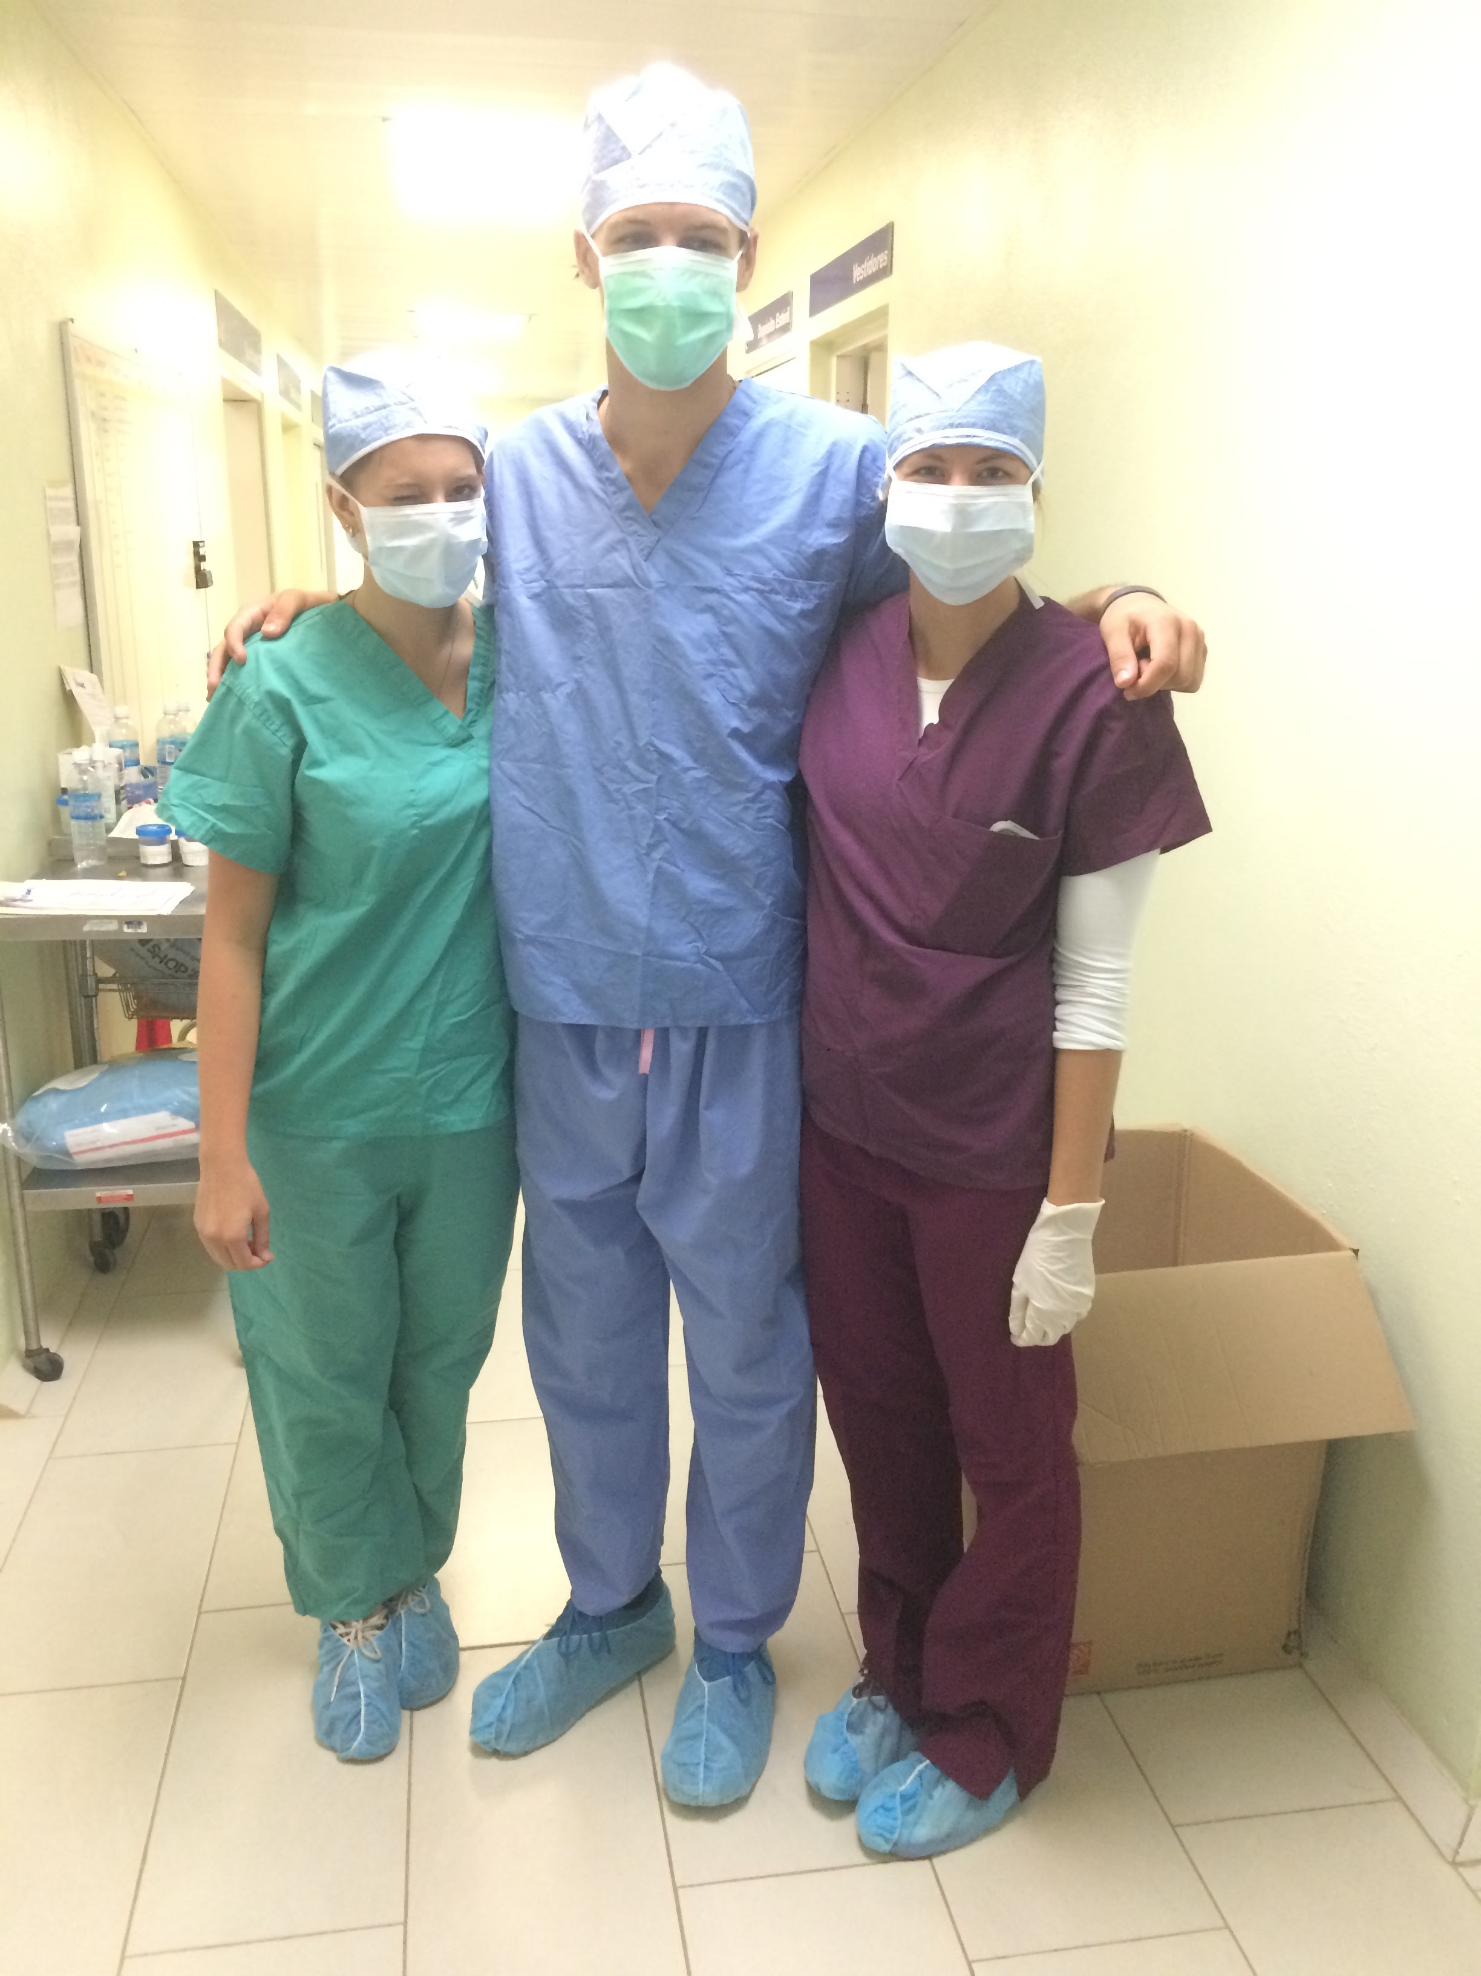

Slide 10
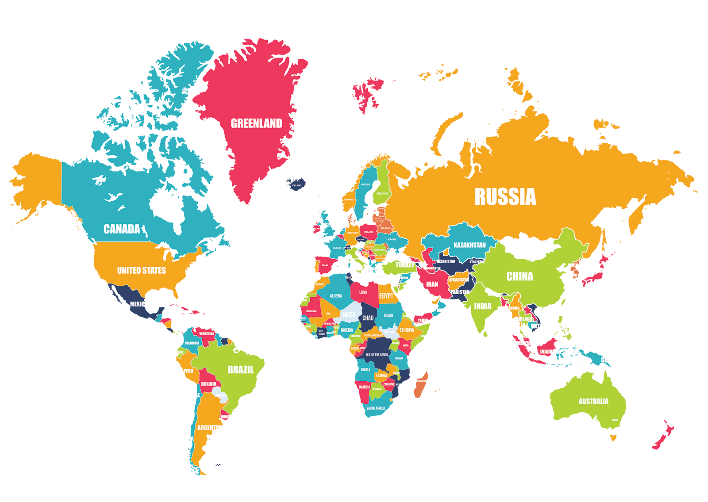
Creighton Programs
Creighton in Ireland
Courses with international and local
students at the University of Limerick
Core and major-specific courses available
On-campus housing
Creighton in South Africa
2 Marquette University courses about justice and social analysis
Variety of courses at University of Western Cape with South African students, largely Core classes
Regular service-learning sites

Slide 11
Creighton Programs
Creighton in Scotland
Courses with international and local
students at the University of Glasgow
Core and major courses available
Separate Honors Program
Off-campus apartments

Slide 12
Creighton Programs
Creighton in Italy
Courses with international and local students at John Cabot
University in (Rome, Italy)
Wide selection of Core and major-specific courses
Live in student dorms near campus
Notes:
Add Galapagos for biology!

Slide 13
Creighton Programs
Creighton in Australia
Courses with international and local students at University of Sydney
Wide variety of Core and Major-specific courses available
On-campus apartments

Slide 14
Creighton Programs
Creighton in the Galápagos
3 Course “Tracks” in English
Ideal for EVS, Ecology, & Sustainability majors
Host family stays

Slide 15
Creighton Programs
Creighton in South Korea
Courses with international and local students at
Sogang University, Jesuit university
Wide variety of Core and Major-specific courses available
On-campus dorms
Creighton in Japan
Courses with international and local students at Sophia
University, Jesuit University
Core and Major-specific courses available
Green Science Program
On-campus dorms, apartment, or host family stay

Slide 16
Creighton Programs
Creighton around the World
ISEP Exchange is an organization that offers
Creighton students the opportunity to study at over
150 other universities for “the price of Creighton”
Pay CU tuition, room, board, and fees, and receive
the equivalent at worldwide locations from Argentina
to Vietnam!

Slide 17


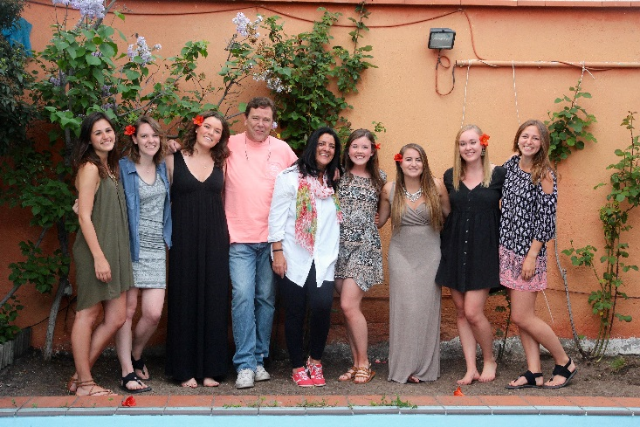
Non-Creighton Programs
Saint Louis University-Madrid
American, Jesuit university in Madrid, Spain
Spanish is not a pre-requisite
Focus on service-learning courses
Wide offering of core classes
Live with a host family
*Pre-Health: Organic Chemistry, Cell Bio, Stats, Public/Global Health
*Always consult with a pre-health advisor before taking
Pre-requisite science courses abroad

Slide 18


Non-Creighton Programs
(Loyola Chicago’s) John Felice Rome Center
American, Jesuit university in Rome, Italy
Italian not a pre-requisite, but 1 class in Italian required while abroad
Focus on service-learning courses
Literature, Art, History, Philosophy, Theology Core classes
*Pre-Health: Genetics, Cell Bio, Statistics,
On or off campus apartments
*Consult with a Pre-Health Advisor before taking pre-req sciences abroad
ISA: International Studies Abroad
Sydney, Australia
London, England
Valencia, Spain
Lima, Peru
Buenos Aires, Argentina
Wide variety programs for semester, summer, or whole year around the world
Include excursions and on-site learning
Usually a lower array of course offerings, but are more culturally specific classes

Slide 19
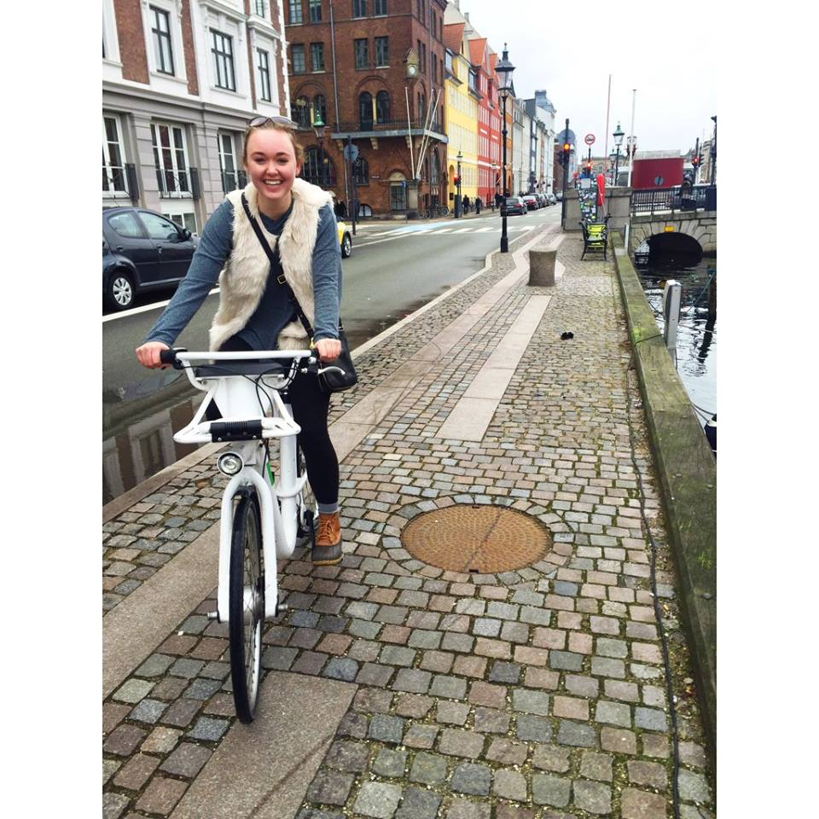

Non-Creighton Programs
DIS: Danish Institute for Study Abroad
Campuses in Copenhagen and Stockholm, Denmark
“hands-on, experiential learning”
Includes 2 themed “study tours” around Europe
Wide variety of courses, with 25 “core tracks”
Additional (optional) study tours and excursions
Specifically for *Pre-Health: Public Health, Medical Policy & Practice, Neuroscience and Biomedicine core tracks
Include shadowing in Danish Hospitals, visiting pharmaceutical labs, touring the WHO
*Consult with a Pre-Health Advisor before taking pre-req sciences abroad

Slide 20
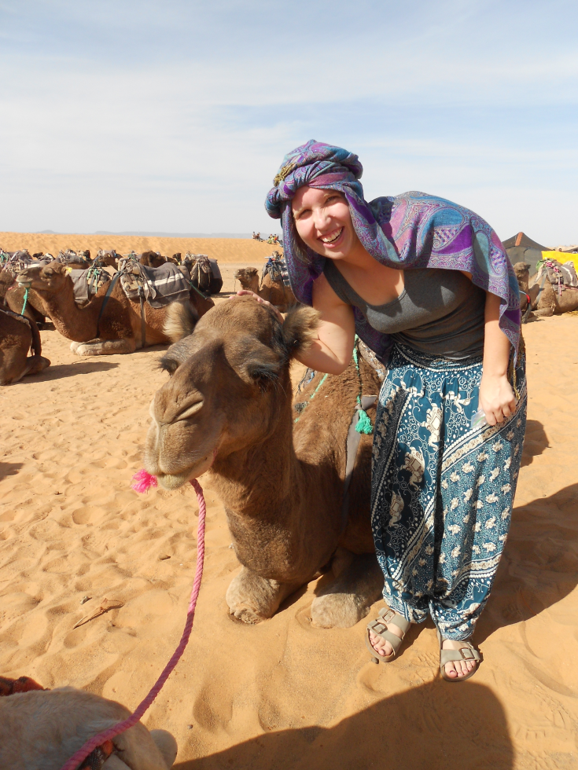
Estimated Cost Calculator
First: FIND YOUR PRICE POINT!
A Non-Creighton program may cost the same as, more, or less than your current Creighton bill.
Check the Nest and talk with your family to find out what you pay and if an outside program is a better deal for you.
Notes:
As a review, on some programs, your federal financial aid AND your institution/Creighton aid will be portable and on other programs only your federal financial aid will be portable.

Slide 21
Tips to Get Started
Start early. 6-12 months out, you should start talking to your academic advisor and the Global Engagement Office.
View the Sample Course Plans on the Study Abroad Website
Do some digging. Go to the study abroad website & check out programs.
Talk to an expert. Speak with a student Peer Advisor! Office hours and contact info are on the Study Abroad website.
Meet with a Global Programs Coordinator. GP Coordinator open hours are Tuesdays and Wednesdays from 9-11am. Drop in to ask a question or get more information about programs.
**You can also set up a meeting on Creighton Connect or by calling the GEO.
Notes:
We’ve divided the steps into 3 different categories: Planning, Applying and Preparing. After this session, you may want to meet with a Peer Advisor or Global Programs Coordinator for individual advising, or you may already know which program you are interested in. Be sure to check out the Study Abroad website to do some research, and bring your 4-year plan to any advising appointment you have.

Slide 22
Application Deadlines
Remember the deadlines to apply…
Term of Participation | Creighton Application Deadline
Fall Semester or Academic Year | March 1
Spring Semester | October 1
Summer Term and FLPA trips | March 1
Submit as early as possible! An outside program’s deadline may differ from the Creighton application.
Notes:
Deadlines are firm to keep programs on track. Priority deadlines help extend your planning time.

Slide 23






